Slide 1

Master of Computer and Information Sciences
Research Methods 1
Quantitative Analysis

Slide 2
http://www.youtube.com/watch?v=2O7K-8G2nwU

Slide 3
Objectives
At the end of this session, you should:
  Understand the role of statistical techniques in analysing the results of experimental research
  Gain a basic understanding of the different types of analysis available
  Interpret the results of Statistical Analysis

Slide 4
Data Analysis
Statistical analysis provides rigour in analysing the results of experiments
Such techniques enable us to make inferences about our experimental (and survey) results with a high degree of confidence
With correct use of statistics we can make inferences about populations from sample data

Slide 5
Data Analysis – The Big Picture
Data Analysis is a vast subject
Different approaches exist:
  Qualitative methods – finding themes in data
  Data Mining – finding patterns in data using machine learning approaches
  Quantitative methods – making inferences about a population from a sample

Slide 6
Data Mining
Itself is a vast subject but some typical applications include:
  Profiling customers who apply for a loan into high risk and low risk categories. Profiles contain risk factors such as income, debt level, job stability, etc.
  Profiling people according to their risk of getting heart disease. Profiles contain risk factors such as status of blood vessels, chest pain after exercise, etc.
  Forecasting on the basis of historical data. Forecasts can be made for vehicular traffic, telecommunication traffic, Internet traffic, etc.
  Discovering patterns of buying behaviour in a supermarket/retailer. Patterns include items that are frequently purchased together.

Slide 7
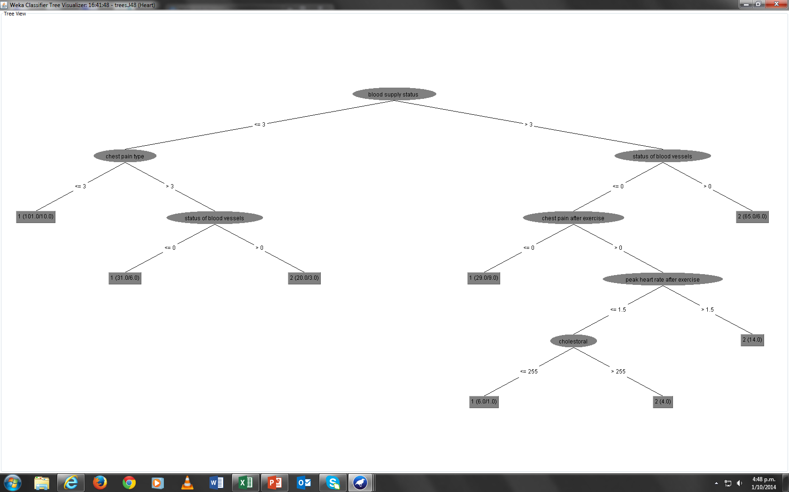
Heart Disease Patterns

Slide 8
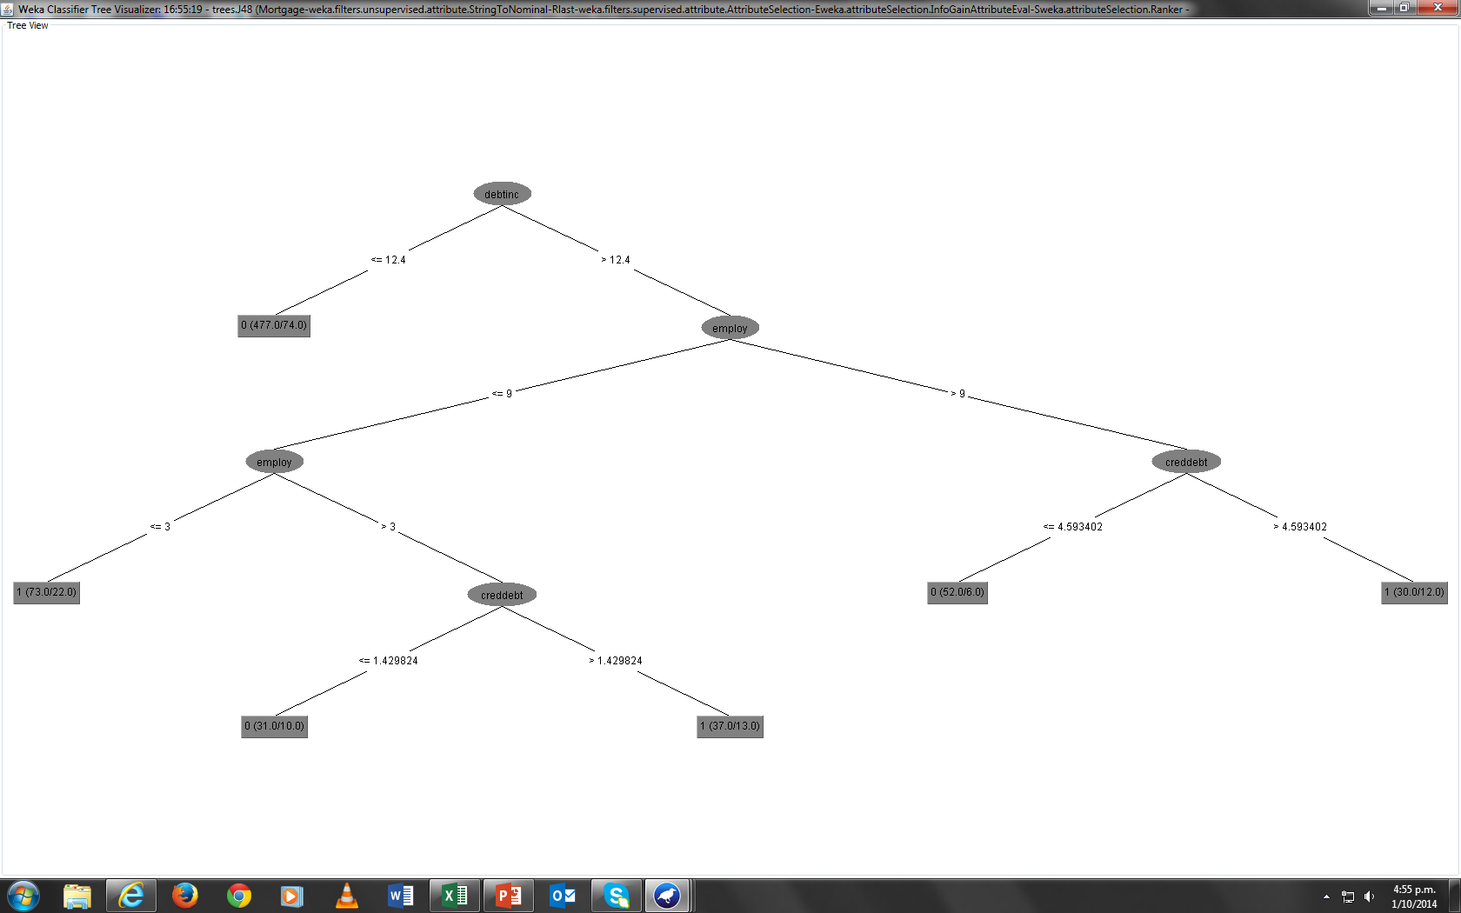
Mortgage Patterns

Slide 9
Quantitative Data Analysis
Almost all research whether qualitative or quantitative ultimately will need to reveal trends in the data.
Qualitative studies such as popularity of web browsers, effects of social networking on workplace productivity, etc. will need to compute suitable statistics

Slide 10
Making Use of Statistics: Part 1
In this part we will focus on some simple methods and how they can be used to reveal insights into data.
We will concentrate on descriptive statistics and their role in data analysis.

Slide 11
Data Summarization
Suppose that are 9 runners in the Olympics 200 metres final and their running times are:
19.2, 19.8, 20.2, 20.4, 21.5, 21.8, 22.1, 22.9, 23.2
The mean (average) value is then 21.2 which is a good measure of central tendency – all values are clustered around the mean
Now imagine that one of the runners fell down, got up and was allowed to finish the race. His time is 60.3
The mean is now 25.4 which is no longer representative of the data as a whole

Slide 12
Data Summarization
Values such as 60.3 are said to be outliers. Such values are not typical values but they may still be valid.
When data distribution is skewed, the median is a better descriptor of central tendency
The median is the middle value and in our case it is 21.5 which is a much better statistic than the mean value due to the outlier

Slide 13
Data Summarization
There are other situations that exist where neither the mean nor the median makes sense
Suppose that we are interested in finding out the number of phones per household in NZ.
Clearly a mean value such as 3.1 is meaningless
A more meaningful statistic in this case is the mode, which is the most frequently occurring value.

Slide 14
Data Summarization
Measures such as mean, median and mode only tell us half of the story.
They hide the other half which is the amount of dispersion (variation) in the data.
Suppose that we want to analyse data on marks at an examination. We collect marks as follows:
The paper is taught in two streams A and B and the marks are as follows:

Slide 15
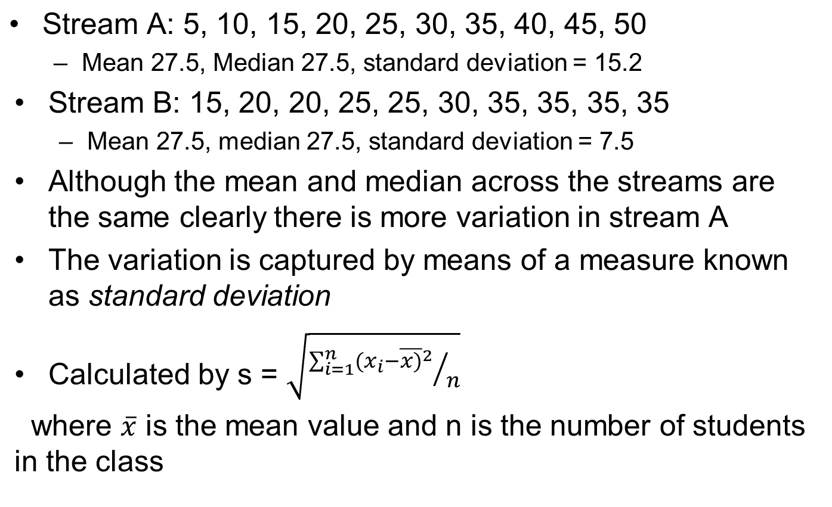
Data Summarization

Slide 16
Data Summarization
For the two streams the s values are 14.4 (A) and 7.2 (B).
This is useful as we can see that more effort/resources need to be put into teaching stream A.
We can also visualize variation through the data distribution curve.

Slide 17
Basic Concepts
Exploration of data is a key preliminary step to performing more sophisticated analysis
Data exploration involves:
  computing descriptive statistics such as the sample mean, median, mode, etc.
  Exploring the inter-relationships that exist between variables
Exploration is followed by confirmatory analysis

Slide 18
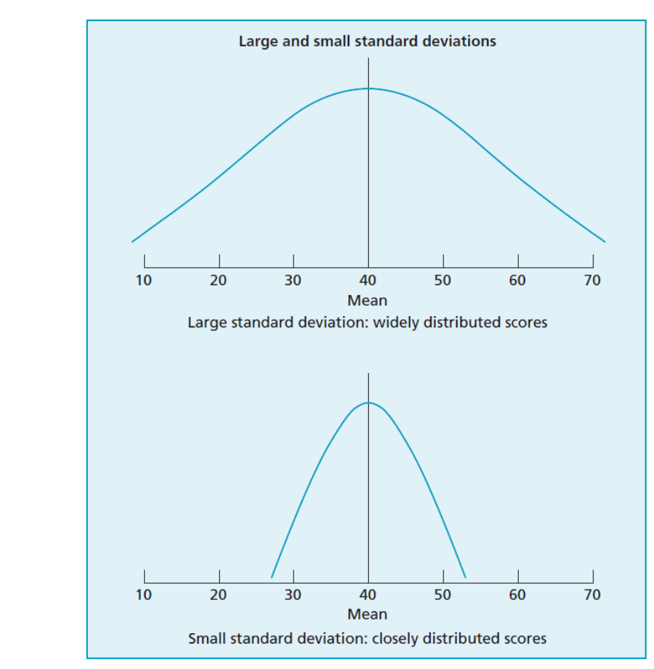
Data Summarization

Slide 19
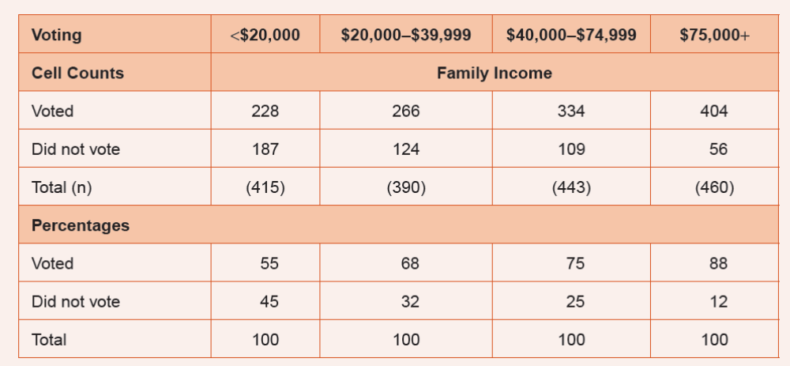
Tracking Relationships
Cross-tabulation can be used as a simple method of tracking relationships

Slide 20
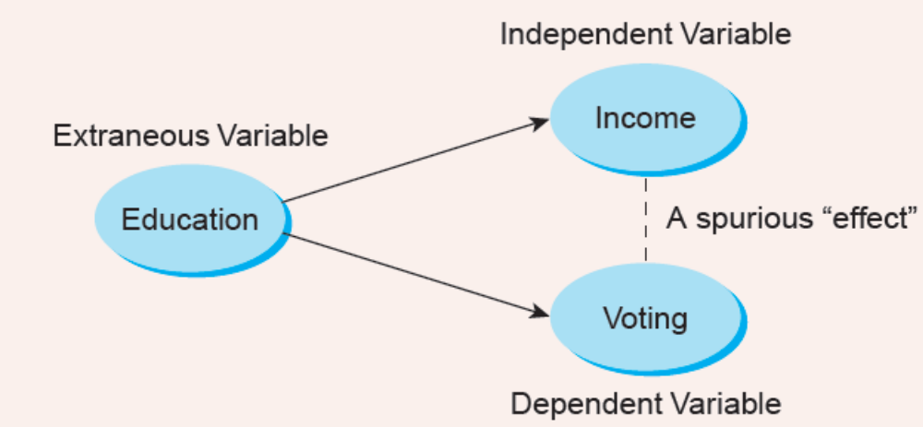
Controlling for a third variable
We can also use cross-tabulation for studying the effect of three variables
Most often this is done to see whether a bi-variate relationship is spurious (not genuine) or not

Slide 21
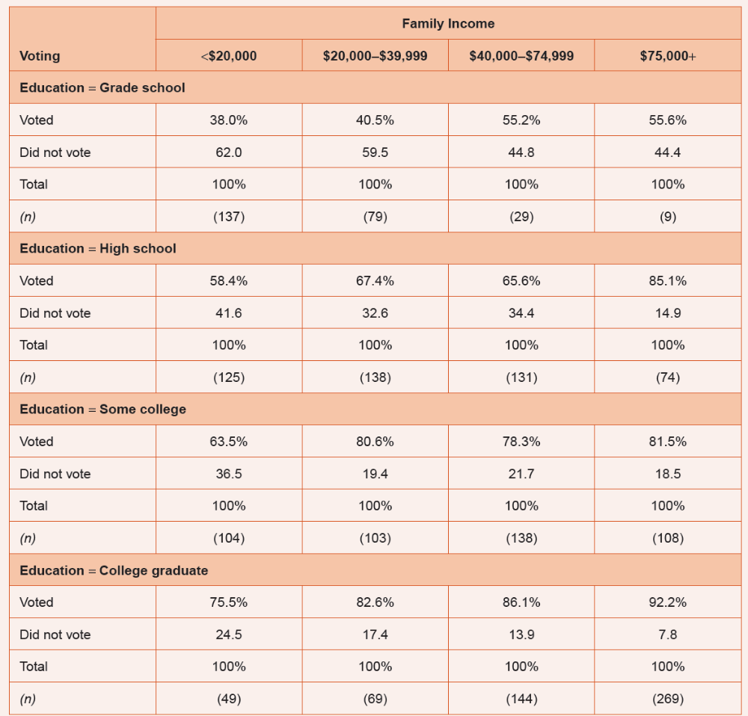
Controlling for a third variable

Slide 22
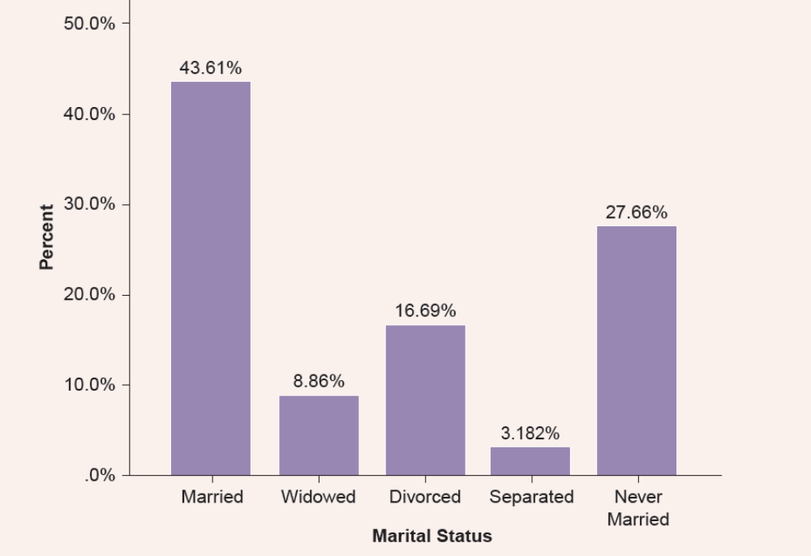
Data Presentation
Bar charts and histograms are the most commonly used visualization methods
For nominal (discrete) variables bar charts are suitable

Slide 23
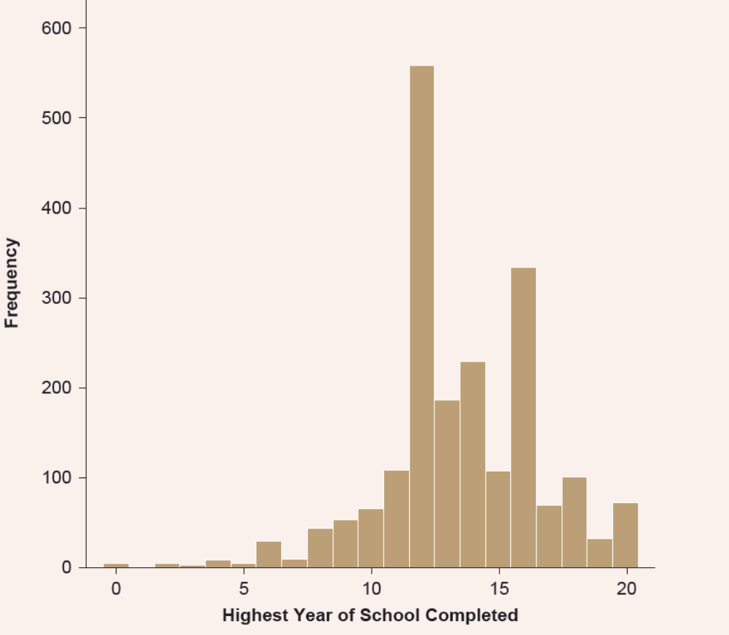
Data Presentation
For numeric variables histograms should be used

Slide 24
Part 2: Inferential Statistics
Q)If you conduct a study to test the effects of the effectiveness of a blood pressure drug how can you tell whether your results are reliable (i.e. can they be replicated?)
A) Inferential statistics can be used as it contains methods that generalize from a sample to a population

Slide 25
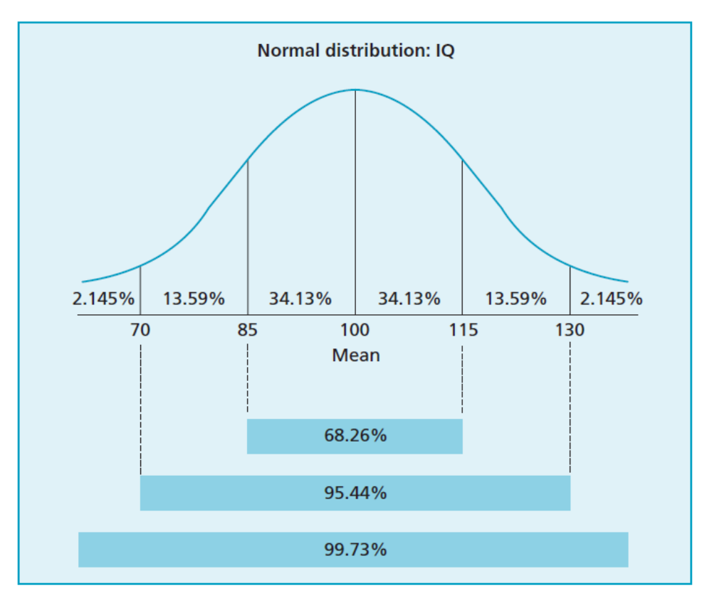
The Gaussian (Normal) Distribution
This is the most important distributions and reflects many real-world situations.
It can be used to model situations like the weight of a set of people, height, etc.

Slide 26
The Gaussian (Normal) Distribution
If our data has a good fit with the Gaussian distribution then we can use a number of useful statistical tests
But in some cases data does not follow a Gaussian distribution
If we record the number of calls received at a switchboard per hour and plot a histogram then it will not fit a Gaussian distribution
But if we take samples across many days (say a month) and plot a histogram with the mean value then it will provide a good fit with the Gaussian distribution

Slide 27
The Central Limit Theorem
States that the distribution of the mean of a set of samples approximates the Normal distribution irrespective of whether the parent distribution is normal or not http://www.statisticalengineering.com/central_limit_theorem.htm
The “closeness’ to normal is dependent on the sample size; generally a size of 30 or more provides a good approximation
For a smaller sample size the distribution of means fit a t distribution more closely

Slide 28
The implications of the Theorem
In experimental based research that seeks to compare the effects of two (or more) different treatments this opens up a vast array of techniques that depend on the normality assumption
We can now compute the means of the different samples and use the Normal distribution to test whether or not the treatments have different effects

Slide 29
Hypothesis Testing
We formulate two hypotheses:
  The null hypothesis H₀: the two sample means are the same
  The alternative hypothesis, H₁: the means are different
The next step is to decide on a confidence level for the test (α)
The parameter α is the probability of wrongly rejecting the null hypothesis if it is in fact true
http://www.cas.lancs.ac.uk/glossary_v1.1/hyptest.html
Smaller values (e.g., 0.01) allow us to have greater faith in either rejecting or not rejecting the null hypothesis
Notes:
Use the diet study data set with the two way paired samples t test
Use the triglycerides to show no significant change
Use the weight fields to show significance

Slide 30
Analysis of Variance (ANOVA)
The ANOVA is the method of choice when more than 2 groups need to be compared http://www.uwsp.edu/psych/stat/12/anova-1w.htm
In these situations, t-test comparisons are not desirable because:
  The number of tests increases exponentially with the number of groups
  The type I error increases in direct proportion to the number of tests conducted
SPSS provides extensive support for ANOVA, allowing the experimenter to isolate those groups that stand out from the rest
Notes:
Use the salesperformance and dvdplayer data sets for illustration

